Slide 1

Class and Object
Object-Oriented Programming
OCCC
Computer Science

Slide 2
Introduction
This lecture is about two basic concepts in Object-Oriented Programming (OOP): data abstraction and encapsulation
After this lecture, you will know:
  what are the components of class
  what is encapsulation in OOP
  how to write class

Slide 3
Where we are now
Review basic concepts: class and object
Components of class
Encapsulation in class
Examples of writing a class

Slide 4
Concept Review : Class & Object
Class represents the set of objects with similar attributes and behaviors, while object represents an entity in the real world
Class is the template to create objects; object is the concrete example of class. Abstraction vs Instantiation
class
abstraction
Instantiation
object

Slide 5
Where we are now
Review basic concepts: class and object
Components of class
Encapsulation in class
Examples of writing a class : Jeep class

Slide 6
Components of class
Since class abstracts information from real world objects, what are these information (components) ?
  Data that represent the characteristics of object
  Methods that represents the behavior of object

Slide 7
Where we are now
Review basic concepts: class and object
Components of class
Encapsulation in class
Examples of writing a class : Jeep class

Slide 8
Encapsulation -- definition
Definition: it is information hiding, which hides the data members, so that no user class can manipulate the data without using the public methods in the same class. Encapsulation also hides the internal methods of the class.
class
private
NO ACCESS
data and
methods
public
Can be accessed
by other class
methods

Slide 9
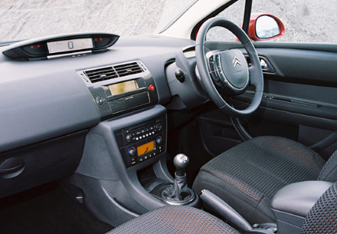
Encapsulation --- consequence
After encapsulation, what does an class/object look like to its user?
  black box
The only way to modify data is through the predefined methods (interface), and this results in safe manipulation of data since correct use of object is anticipated through the predefined method(s).
However, the designer’s view of a class should be white box, since the designer knows everything inside the class, including private data members, plus public methods.

Slide 10
The OOP encapsulation principle compared to car
The private data of a class are comparable to the “magic stuff” under the hood of a car
The public methods of a class is comparable to the handlers a driver can operate when sitting in the driver’s seat: the steering wheel, the break, the gas pedal, the gear, etc
As a driver, thank goodness, he/she does not need to know what is under the hood, and all he/she needs to know is how to manipulate the handlers in front of the driver seat ; just like the user of a class only needs to know how to use the public method, and no need to know what are the private data inside a class.

Slide 11
Where we are now
Review basic concepts: class and object
Components of class
Encapsulation in class
Examples of writing a class : Jeep class

Slide 12

Write a class for the radio control jeep
How to design class to represent a Jeep that can move in a one-dimensional space ?
External look: it can move forward and backward
Internal look:
  need a data field to describe its current position;
  need some methods to change its current position

Slide 13

Jeep class details and demos
class design:
  Current position is stored in a data member
  The distance moved each step is randomly generated, and less than MAX per step
  An accessor method returns the current position.
  Mutators change the position
float currentPos;
final MAX;
data
moveForward
(float distance)
moveBackward
(float distance)
getPosition()
methods
0

Slide 14
Summary of this lecture
In this lecture, we have discussed:
  the components of a class,
  encapsulation, including its principle and benefits,
  a radio car example on how to design class

Slide 15
Encapsulation : private data and methods + public interface
Summary chart
class, object, components, encapsulation
class
data
method
abstraction
Instantiation
attribute/ state
object
operation/ behavior

Slide 16

Q & A

